Slide 1
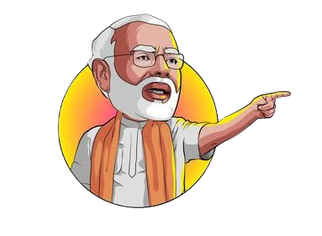
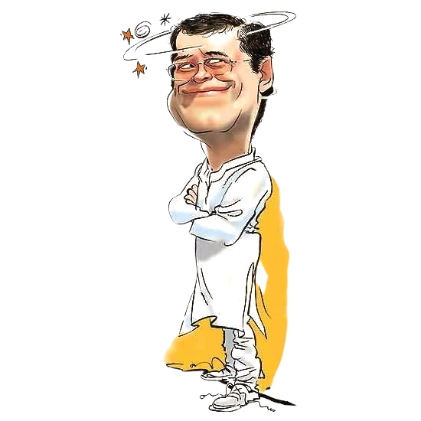

How to win Elections?
Understand the Ecosystem and Social Equations well
Learn the Art of campaigning.
Creating a Buzz
Leverage Technology to your advantage

Slide 2
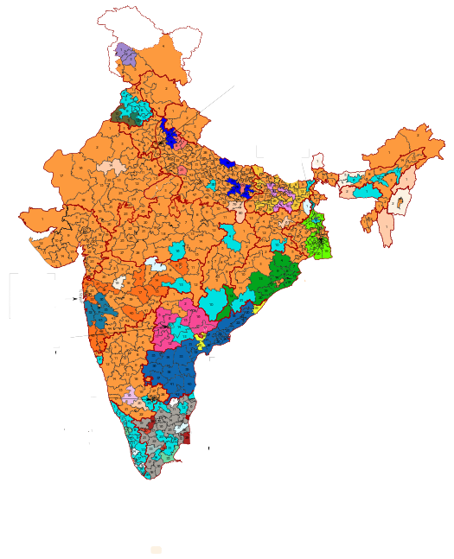
Inside an Election War Room
Objectives:
Our project aims to acquaint you with the basics of Political Consultancy and Election Management. We want to give an insider's view of what happens in an Election War room. We will learn how to use data science tools to analyze data and draw valuable insights from it and how the use of these tools has affected the political landscape.

Slide 3
80
But is political consultancy even a thing?
60
40
In 1984, BJP won a mere 2 out of 541 seats. Fast forward to 2014, it becomes the first party ever since 1984 to get a clear majority. This transition could not have been possible without the help of professionals. This was the first Political campaign which used technology to a whole next level.
20
0
1984 GE
2004 GE
2009 GE
2014 GE
2019 GE

Slide 4
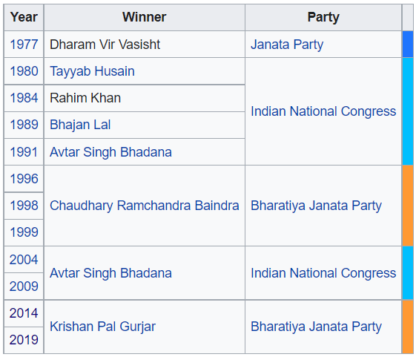
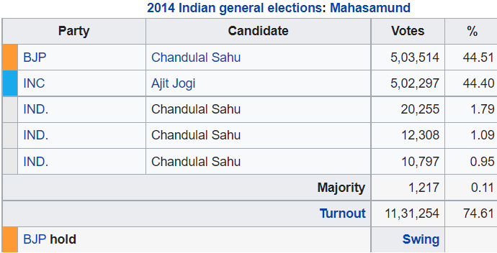
Faridabad
Mahasamund

Slide 5
Project Outline
Basic Terms and Playing with Data
Surveying and Acquiring Data
Traditional Art of Campaign
The Era of Political Consultancy
Campaign Design
Creating a buzz in 21st Century
Caste, Religion and Voting Patterns
Analysis of different Political Factors
Analysis on Constituency Level

Slide 6
Logistics And Pre-requisutes
Pre-Requisites
Project Meeting
None. Just your interest in Politics
Both online and offline
Expected Weekly Commitment
Evaluation Components
Mentors:
Prem Milind Gujrathi
Apoorva Jha
Weekly assignments and readings
Midterm and Final assesment
4-6 hours

Slide 7
"Politics is the ability to foretell what is going to happen tomorrow, next week, next month and next year. And to have the ability afterwards to explain why it didn't happen."
Winston Churchill

Slide 8
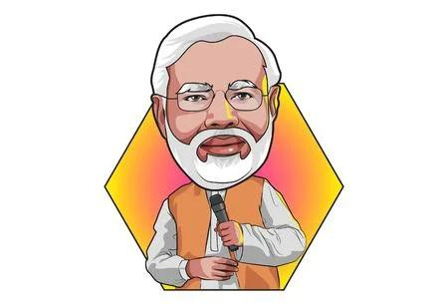
Thank you!
Hope to see you onboard.

